Slide 1
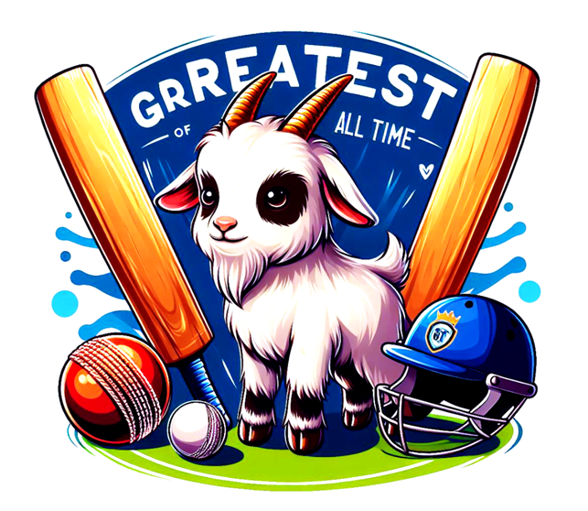
G.O.A.T – Greatest Cricketer of All Time
Capstone Data Analysis Project
Author: Gaurav Gujar

Slide 2
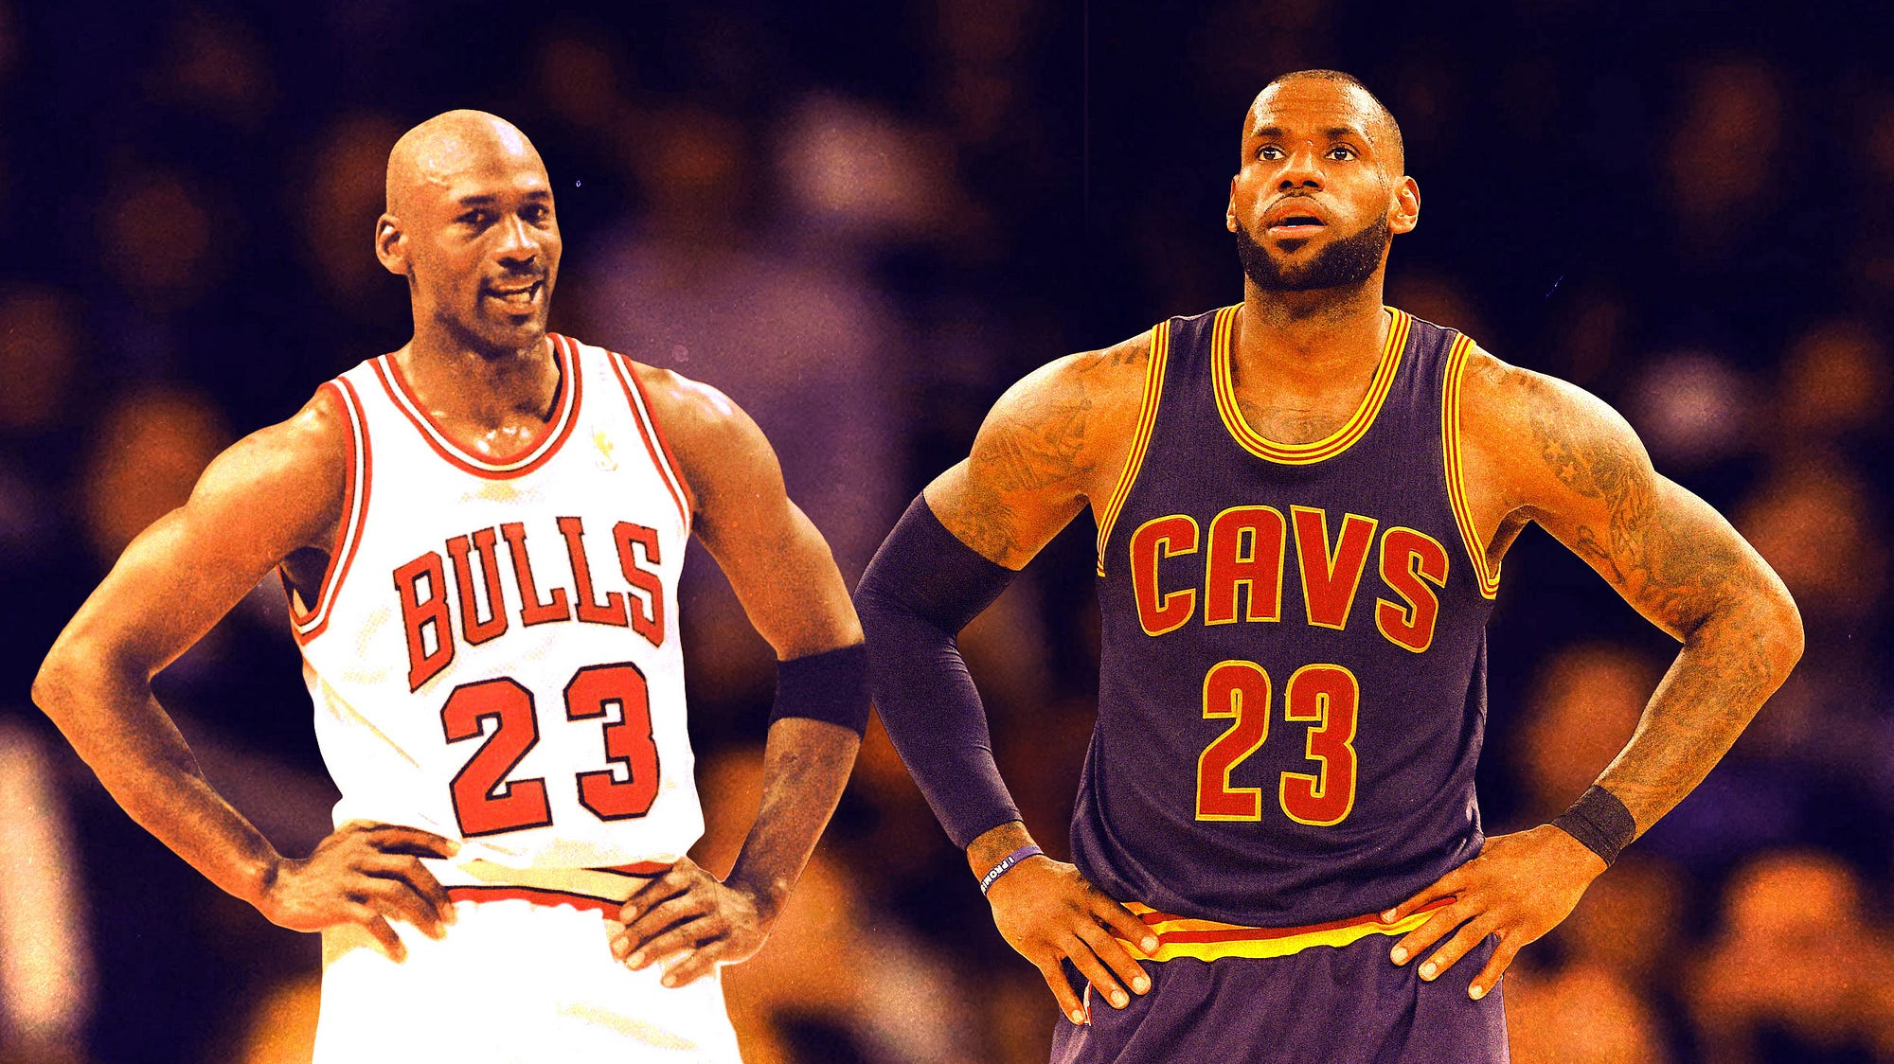
G.O.A.T. of Basketball - Michael Jordan or LeBron James?

Slide 3
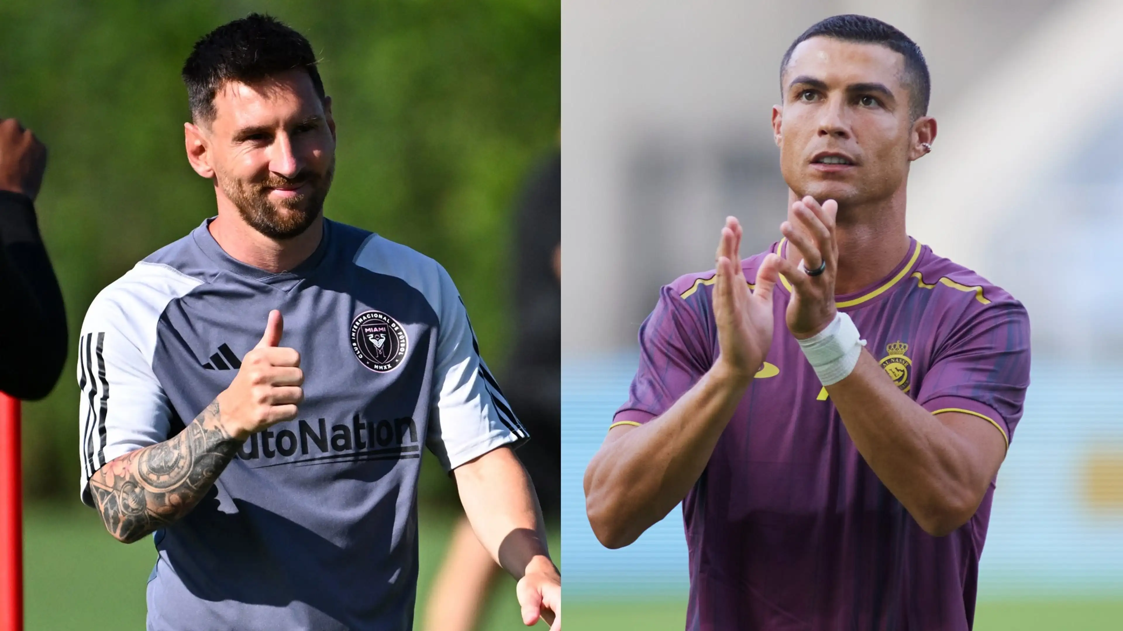
G.O.A.T. of Soccer - Lionel Messi or Christiano Ronaldo?

Slide 4
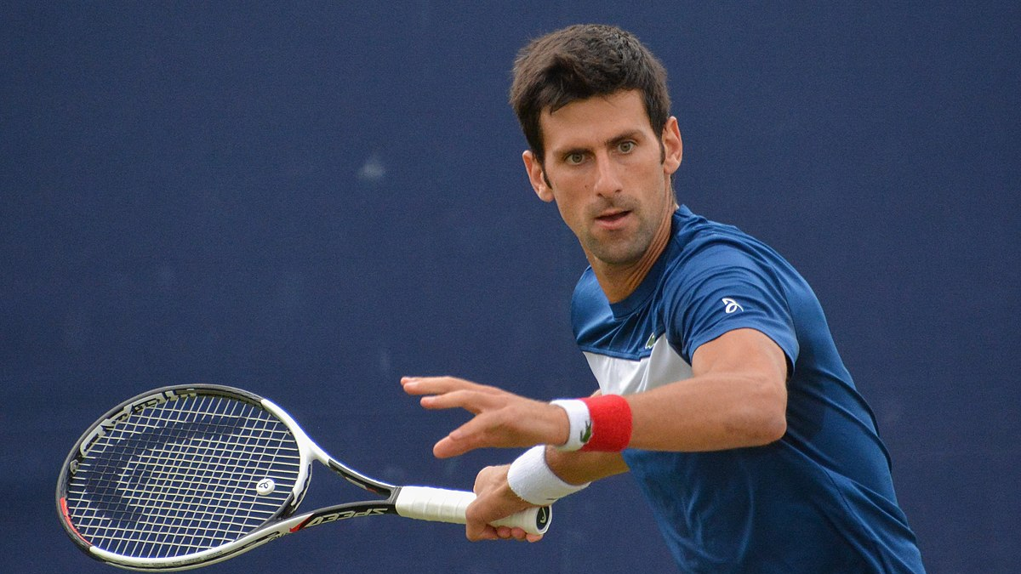
G.O.A.T. of Tennis - Novak Djokovic

Slide 5
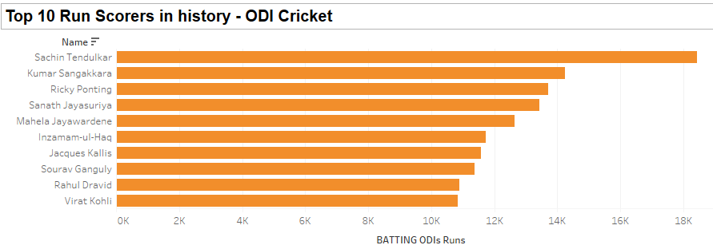

Slide 6
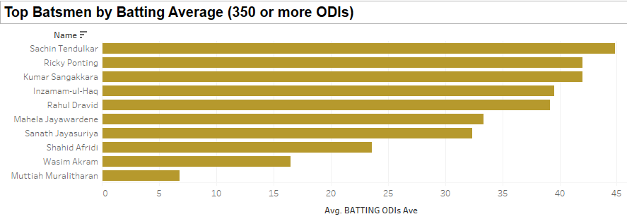

Slide 7
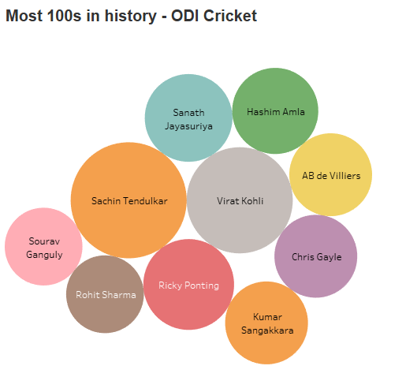

Slide 8
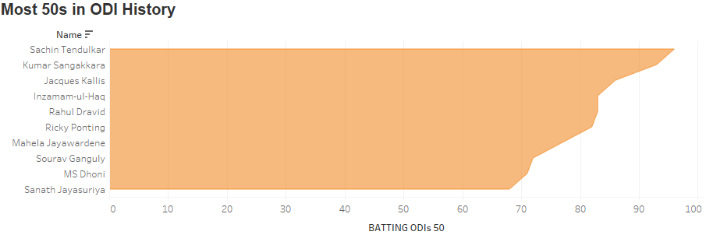

Slide 9
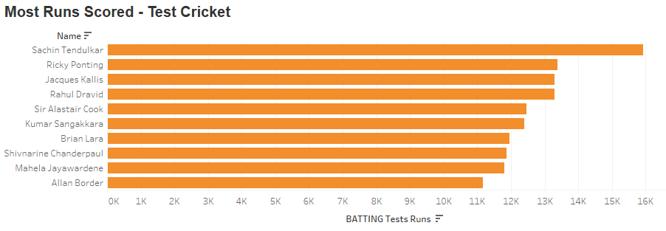

Slide 10
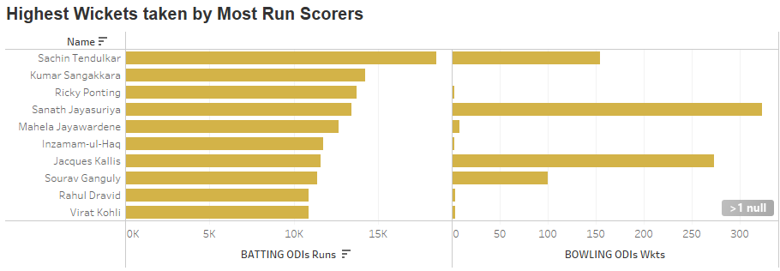

Slide 11
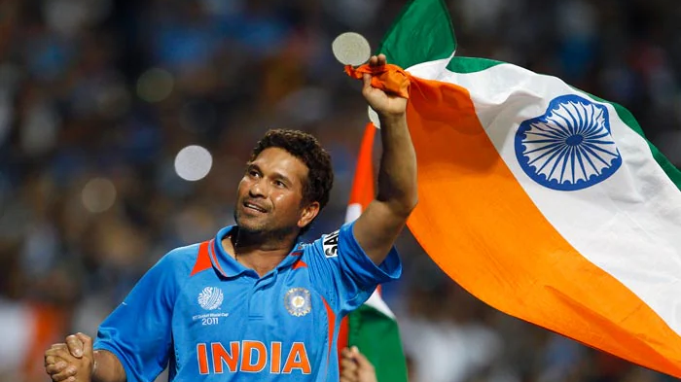
G.O.A.T. of Cricket – Sachin Tendulkar

Slide 12
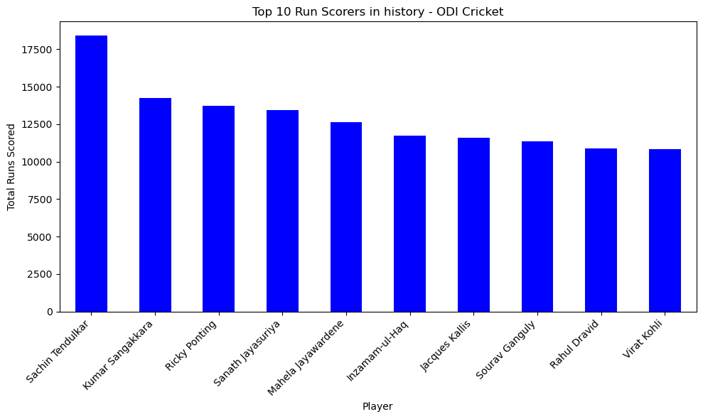

Slide 13
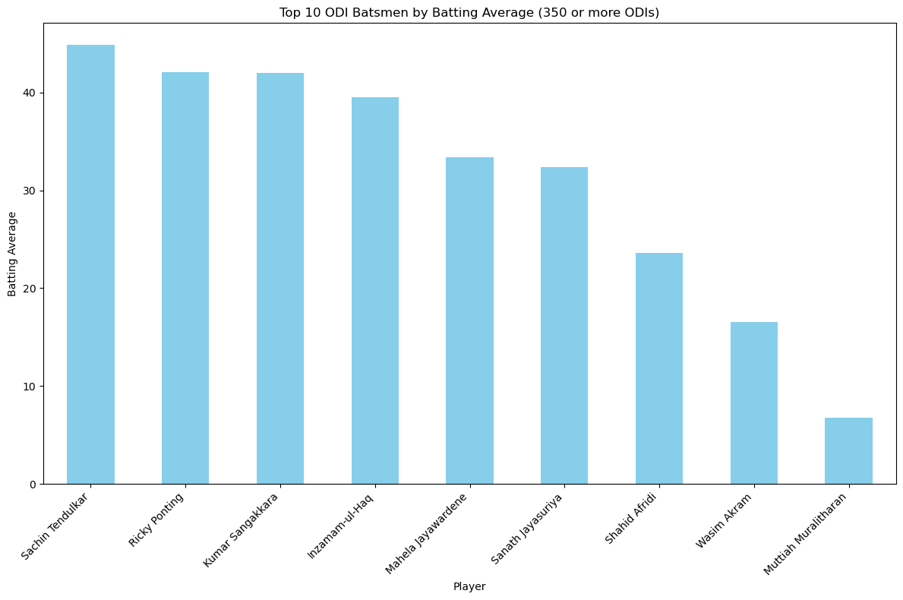

Slide 14
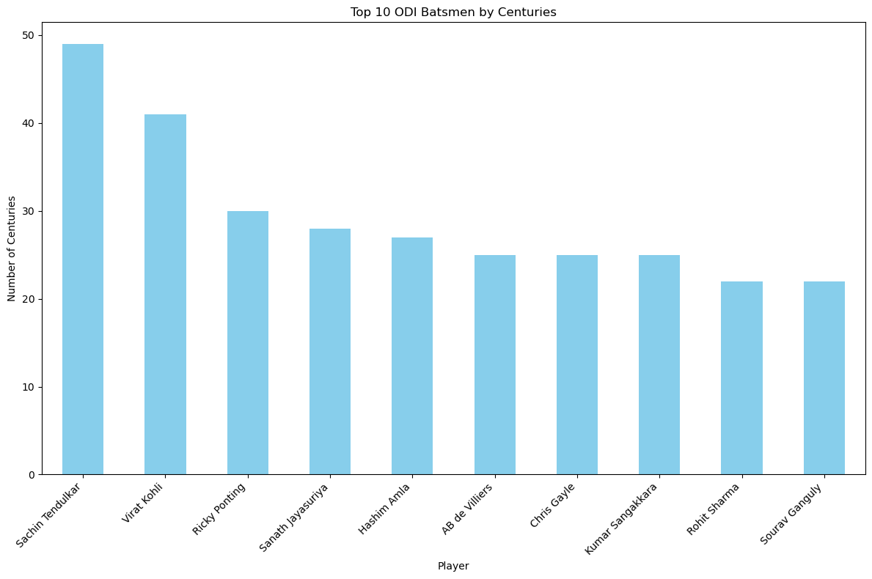
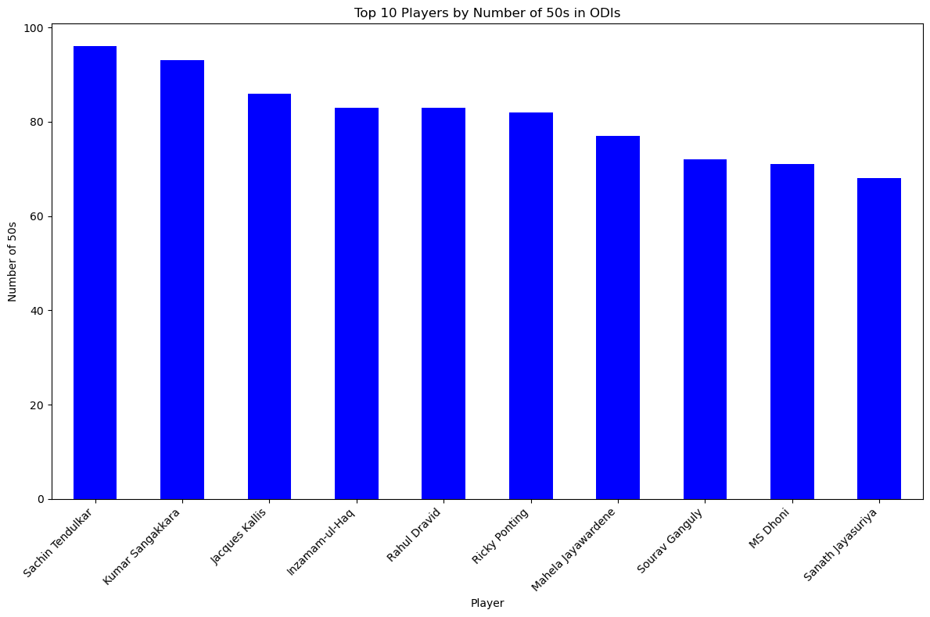

Slide 15
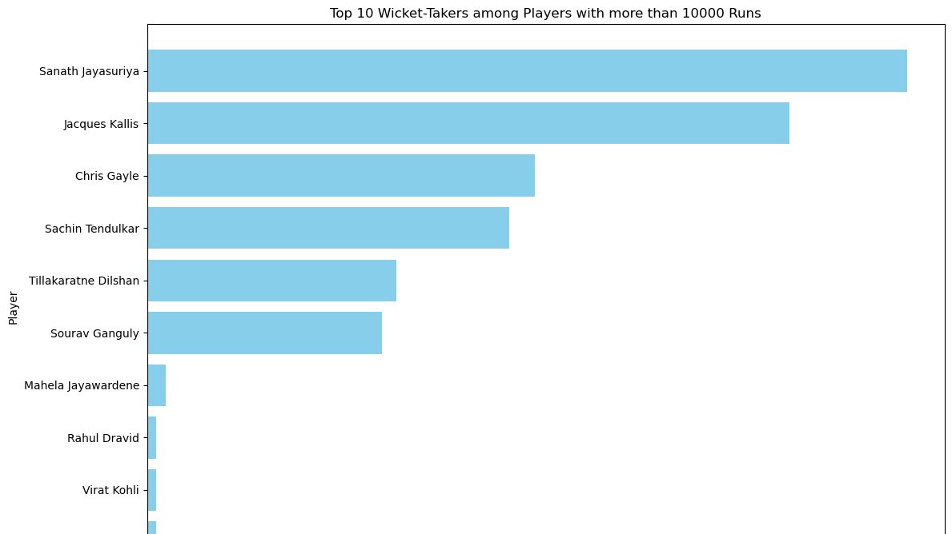

Slide 16
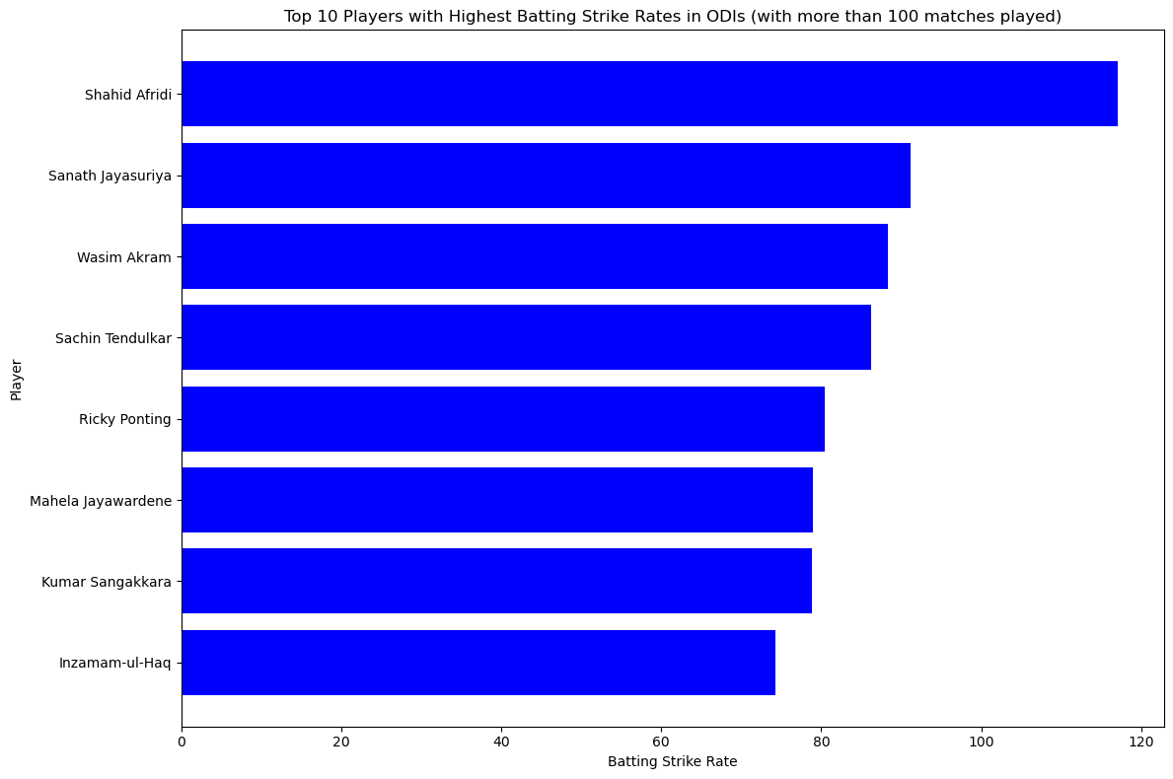

Slide 17
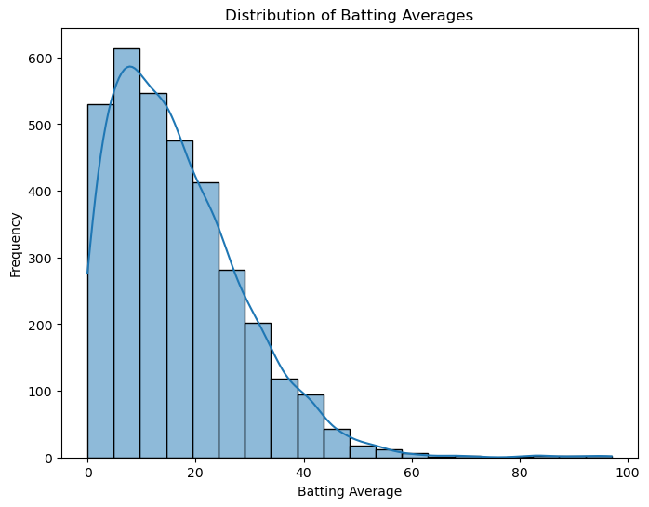
Batting Averages – Sachin is in the TOP percentile of highest averages.

Slide 18
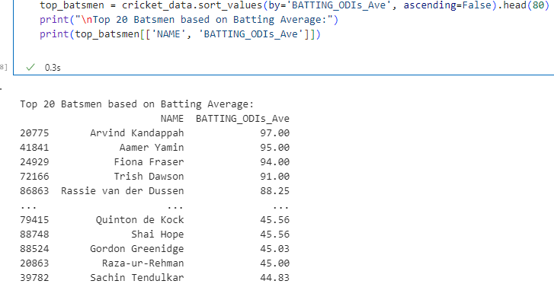
Sachin Batting Average in ODIs – 80th

